Slide 1
The Need for Knowledge in Machine Learning in the Age of Big Data
Huan Liu
with Ruocheng Guo and Kai Shu
Notes:
CNCC2019 Suzhou 10/17/2019

Slide 2
From AI^{K} to AI^{D}
“Knowledge is Power”: AI was then solely about K
  Expert Systems or Rule-based Systems
    “Intelligence is ten million rules.”
  Knowledge-based Systems (Cyc)
“Data is the New Oil”: AI is now obsessed with D
  Unprecedented computing power
  Big data is ubiquitous
Deep learning – everybody’s favorite
  It is just one successful form of Machine Learning
  What can we expect next?

Slide 3
Acquisition and Use of Knowledge
Ideally, ML generalizes from data
  The generalization is hopefully sort of knowledge
The current state-of-the-art of machine learning
  Relying on a lot of labeled data
  Learning to approximate y = f(x) for prediction
Is it explicit knowledge?
  Are predictions robust?
  Can prediction guide decision making?
  Can this type of knowledge be reused?

Slide 4
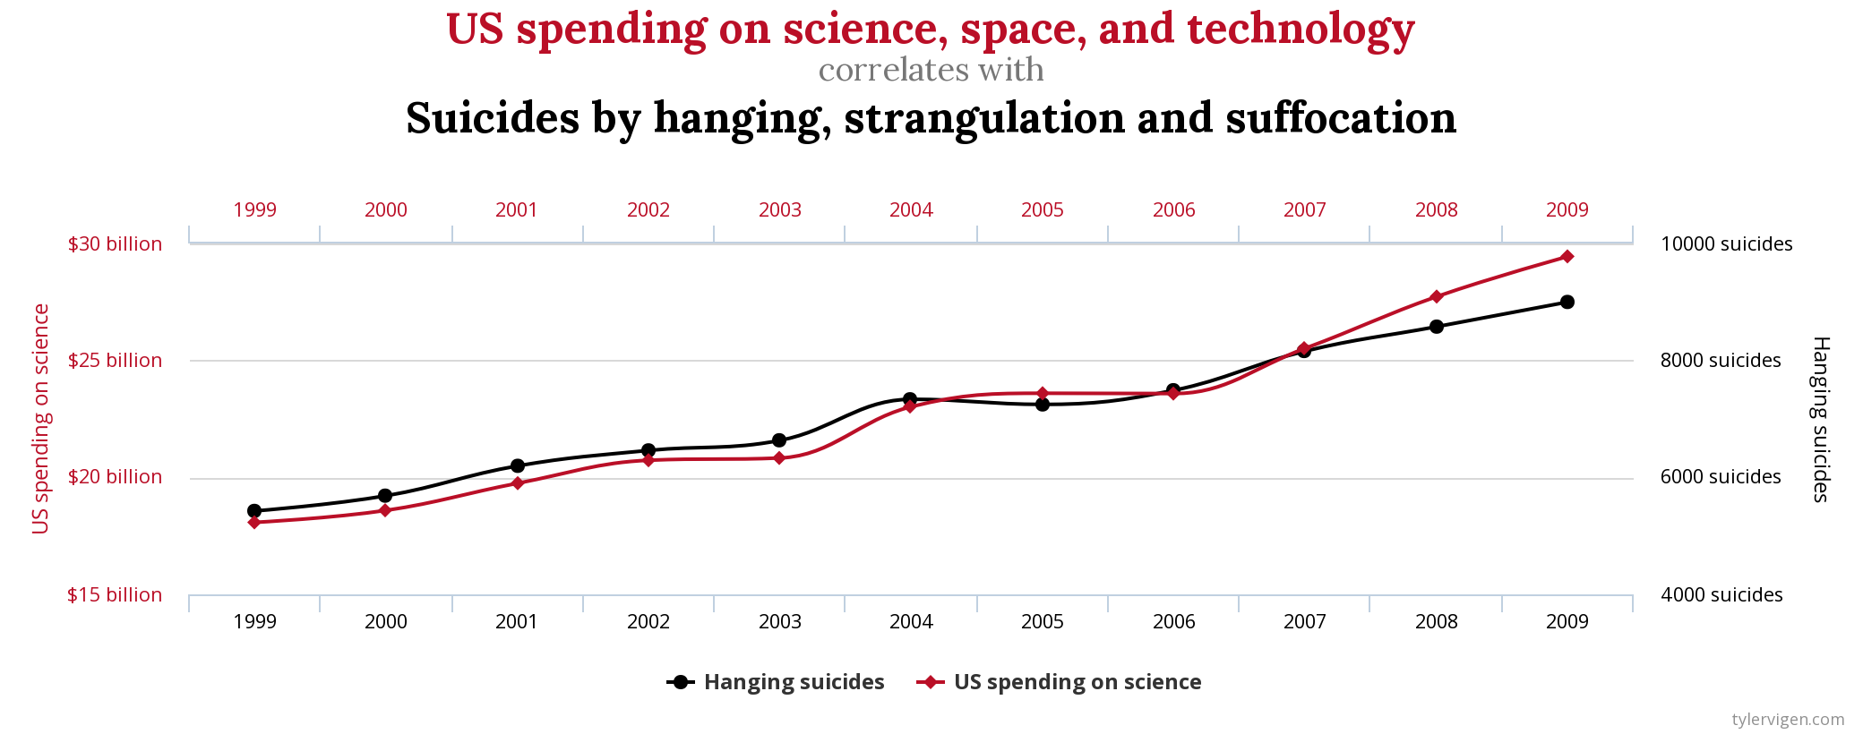
Are Prediction Robust or Reliable?
Correlation can be spurious
Prediction models based on spurious correlation can be unreliable - What if the US decreases its spending on science?
Credit: http://www.tylervigen.com/spurious-correlations

Slide 5
Can prediction guide decision making?
 | Algorithm A | Algorithm B
CTR for Low-income users | 10/400 (2.5%) | 4/200 (2%)
CTR for High-income users | 40/600 (6.6%) | 50/800 (6.2%)
CTR for all users | 50/1000 (5%) | 54/1000 (5.4%)
Observation 1: CTR is higher for Algorithm A in each group (low or high-income)
Observation 2: CTR is higher for Algorithm B in the whole population
Which algorithm is better based on CTR (click through rates)?
Notes:
CTR - click through rate

Slide 6
Additional knowledge is needed
To answer which algorithm is better
              All because the answer depends on underlying causal diagrams
Higher CTR for Algorithm B due to
the algorithm itself
The conditional probability Pr(click|algorithm) reflects the true causal effect (algorithm->click).
Decision: Algorithm B is better
Income
 | Algorithm A | Algorithm B
CTR for all users | 50/1000 (5%) | 54/1000 (5.4%)
See offers recommended by an algorithm
Click
Notes:
We will need external knowledge to determine which causal structure is more valid.

Slide 7
Decision can change with another causal diagram
With a known confounder (income), algorithms can have different impact on CTR
The conditional probability Pr(click|algorithm) does not reflect the true causal effect (algorithm->click)
We need to block the influence from the confounder (income), done by subgrouping
Decision: Algorithm A is better
Higher CTR for an algorithm can be
due to confounding bias
Income
 | Algorithm A | Algorithm B
CTR (Low-income) | 10/400 (2.5%) | 4/200 (2%)
CTR (High-income) | 40/600 (6.6%) | 50/800 (6.2%)
See offers recommended by an algorithm
Click

Slide 8
Causal Learning and Big Data
Pearl’s causal diagrams
A rigorous framework representing causal knowledge
It assumes perfect causal knowledge
Big data
High-dimensional and noisy
Hard to obtain perfect causal knowledge
Can we bridge the gap between causal diagrams and big data?
Facets of big data: networks, text, user preference, ...
Causal knowledge can be inferred or implicitly used
Causal diagrams can be used
Notes:
We can use other forms of weak knowledge

Slide 9
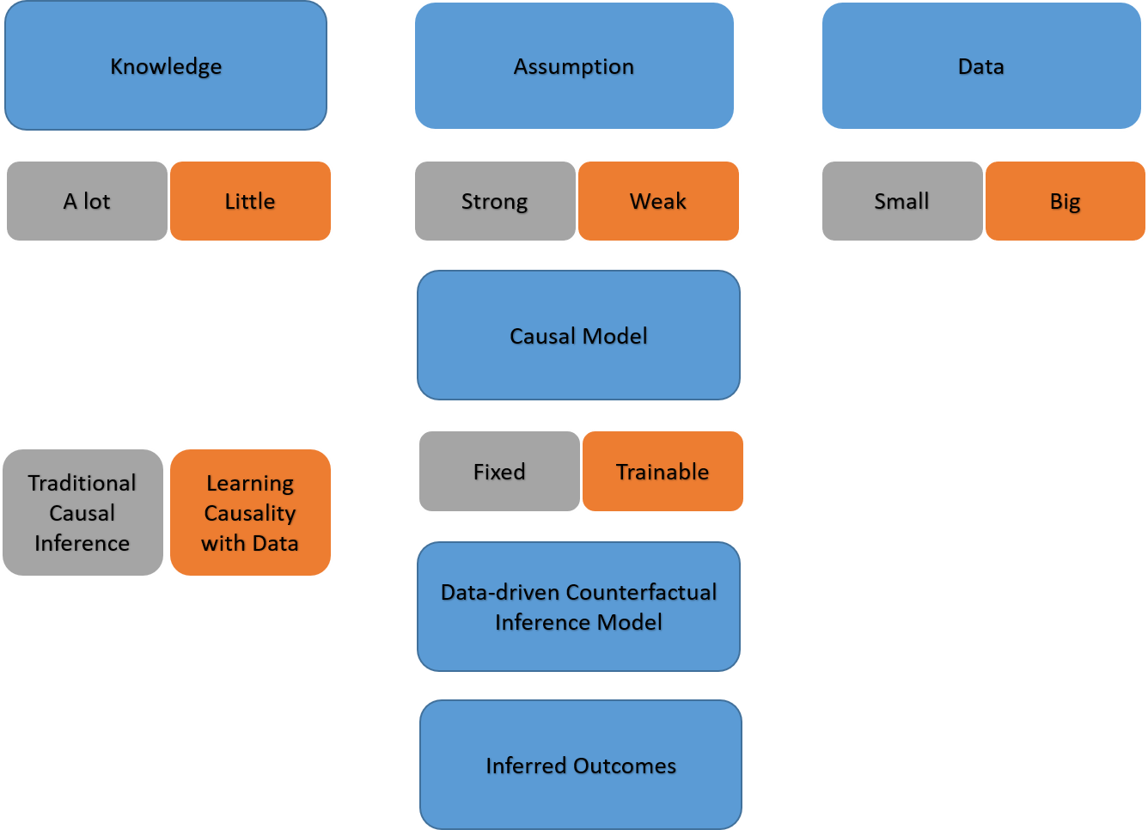
Learning causality with data vs causal inference
Survey by Ruocheng Guo, et al. on
Learning Causality with Data:
Problems and Methods

Slide 10
Figuring out Confounders
Not all observed features are confounders
Judea Pearl: Throwing all observed features into the model can make estimates worse
Can we design methods to select some features as potential confounders?
Not all confounders are observed
  Can we find out missing confounders?
  Can we take into account of hidden confounders?
Notes:
How many confounders are missing?

Slide 11
Network Deconfounder
Estimating individual-level causal effects
  Critical for personalized decision making
  The effect of browsing devices on user experience -> mobile or desktop
  The effect of a job training program on employment -> participate or not
Unbiased estimation requires handling hidden confounders
Auxiliary network information of massive observational data
  E.g., Social networks and Spatial networks of geometric objects etc.
  Network information can capture patterns of hidden confounders
    A blogger’s social network connections can indicate her likings or writing style
Ruocheng Guo, Jundong Li, and Huan Liu. "Learning Individual Causal Effects with Networked Observational Data" WSDM 2020 (arXiv:1906.03485).
Notes:
Mobile phones or laptops or desktops are treatments; writing style or her sentiment can be hidden confounders

Slide 12
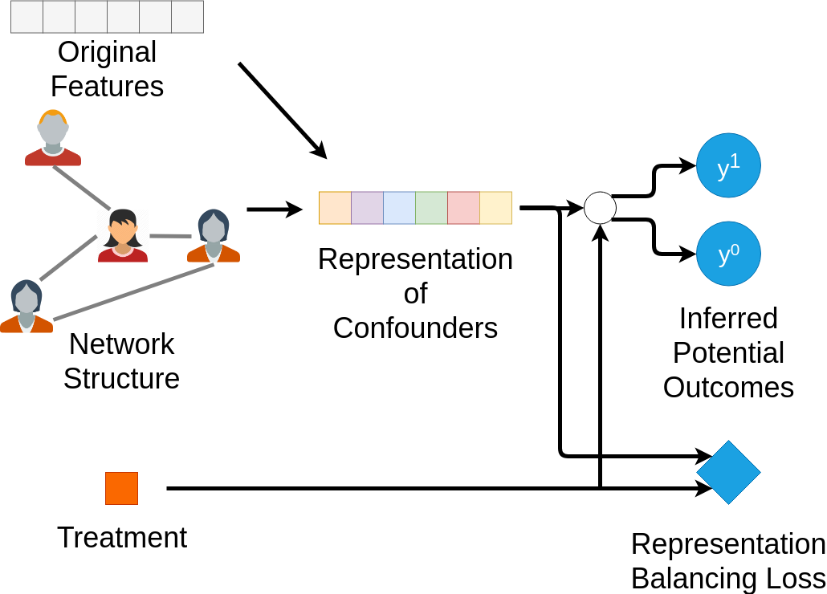
Network Deconfounder
How to leverage network information to handle hidden confounders?
Learning latent representation of confounders from observed features and network information through Graph Convolutional Networks
Utilizing the supervision of observed potential outcomes
Balancing distributions of confounders’ representations to improve the inference of counterfactual outcomes
Ruocheng Guo, Jundong Li, and Huan Liu. "Learning Individual Causal Effects with Networked Observational Data" WSDM 2020 (arXiv:1906.03485).
Notes:
Balance for both treatment and control groups

Slide 13
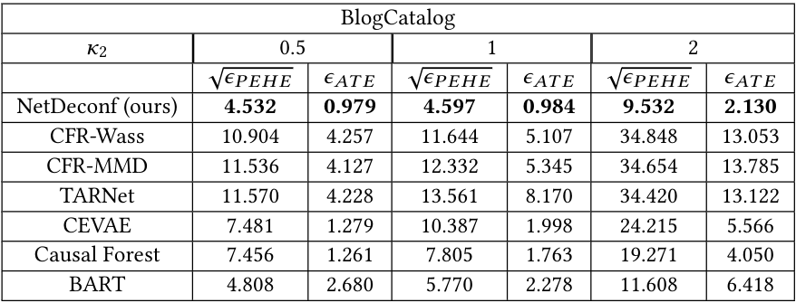
Would Network Deconfounder make a difference
Network Deconfounder outperforms the state-of-the-art methods as it recognizes patterns of hidden confounders from network information
The error of Network Deconfounder increases the least as hidden confounding effect (k2) increases
Notes:
neural network and tree-based methods
Less sensitive to hidden confounders by assuming there are hidden confounders
ATE - average treatment effect; PEHE - Precision on estimated heterogeneous effect

Slide 14
Acquiring and Using Knowledge
Causal learning to acquire knowledge
  Explainable for understanding
  Not specific to one domain for reuse
Evaluation via explanation
  Enabling expert’s verification and intervention
  Facilitating knowledge extraction

Slide 15
Fake News Detection – Important Application
People tend to consume news increasingly more on social media due to the low cost, easy access, and rapid dissemination
Social media also enables the wide dissemination of fake news
  Fake news: news with intentionally false information
Fake news has damaging societal effects
  Confusing readers of what’s real and fake in the news ecosystem
  Misleading people to false information
  Changing the way people interpret and respond to true news

Slide 16


Explainable Fake News Detection
Existing work focuses on detecting fake news, but cannot explain why it is detected as fake
Explanation is important
  Provide insights and knowledge to practitioners
  Extracting explainable features can
further improve the fake news
detection performance
The news is fake because…

Slide 17
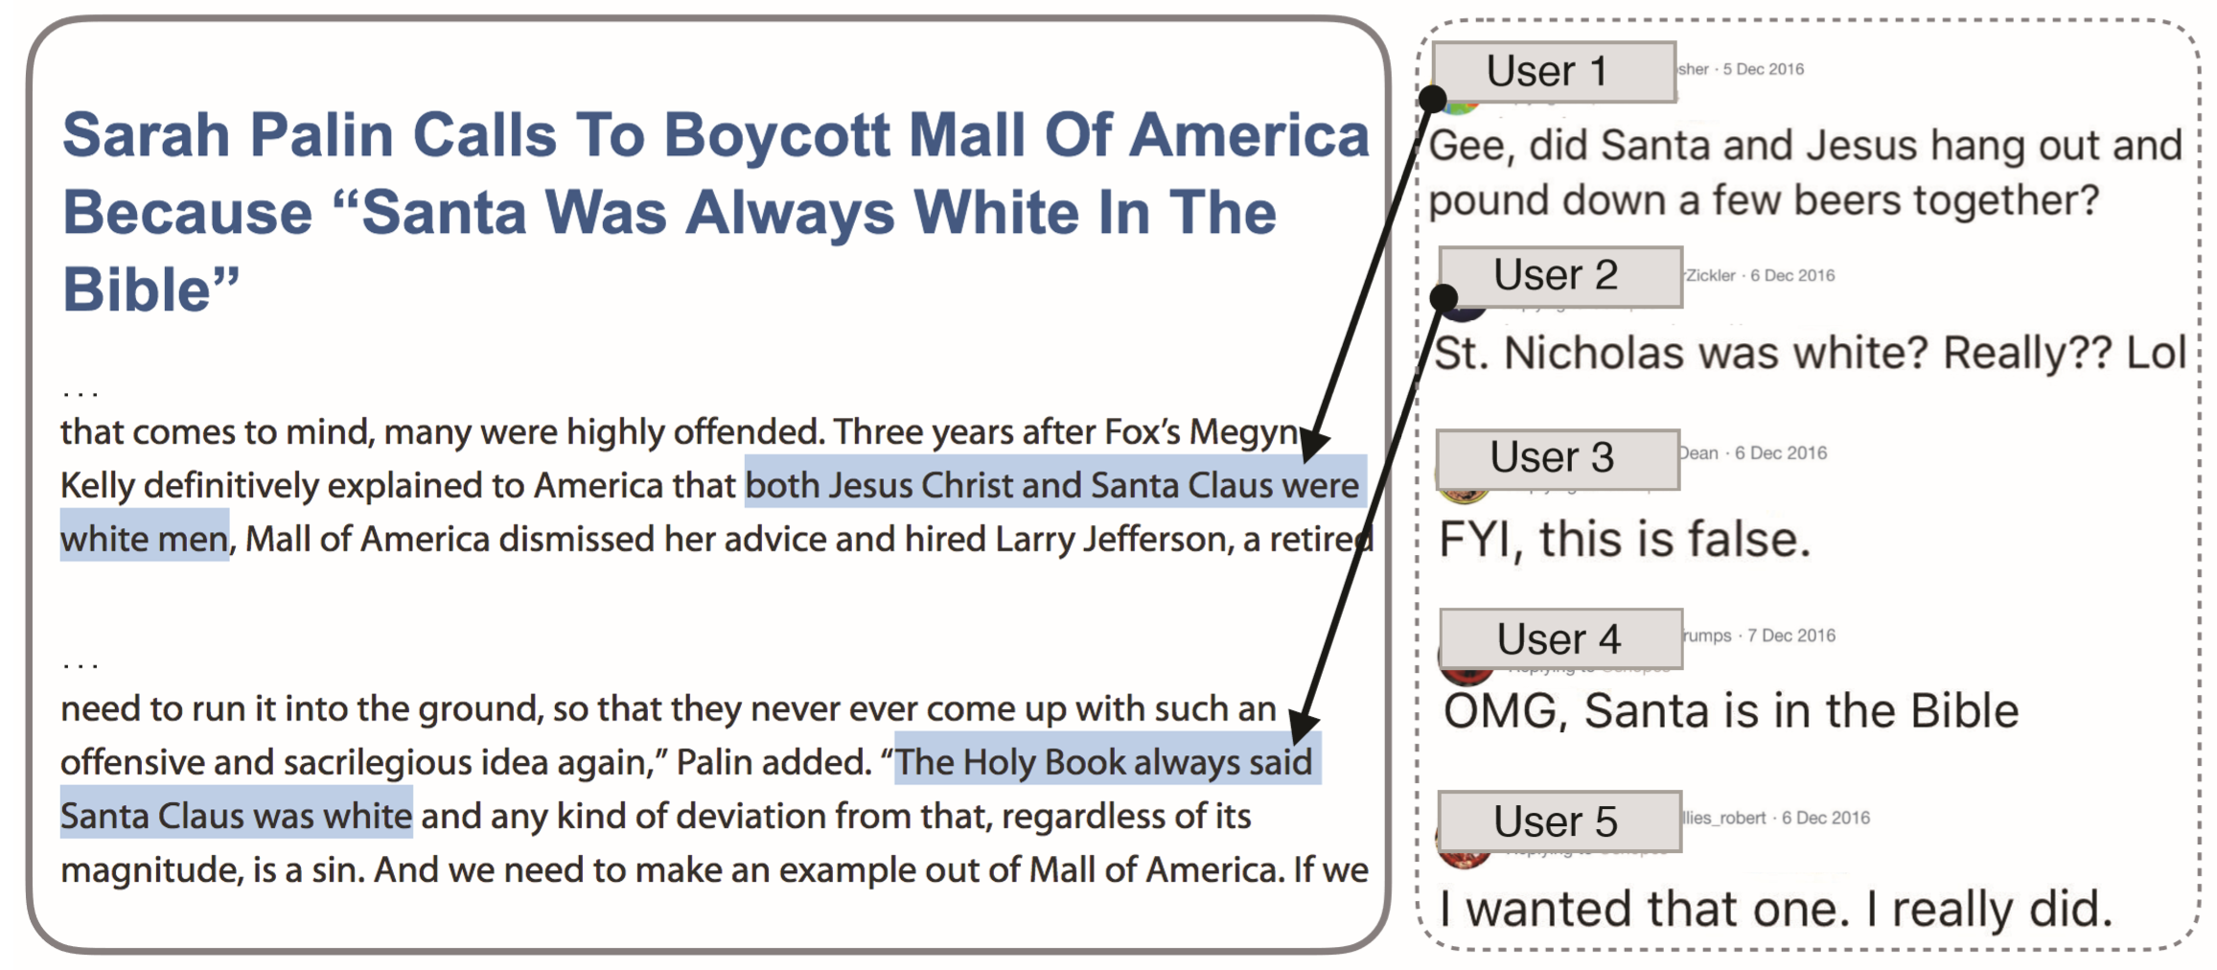
Contents, Comments, and Their Relations
News contents and user comments are inherently related
  News contents contain false information
  User comments have
rich information from
the crowd such as
opinions, stances,
and sentiment

Slide 18
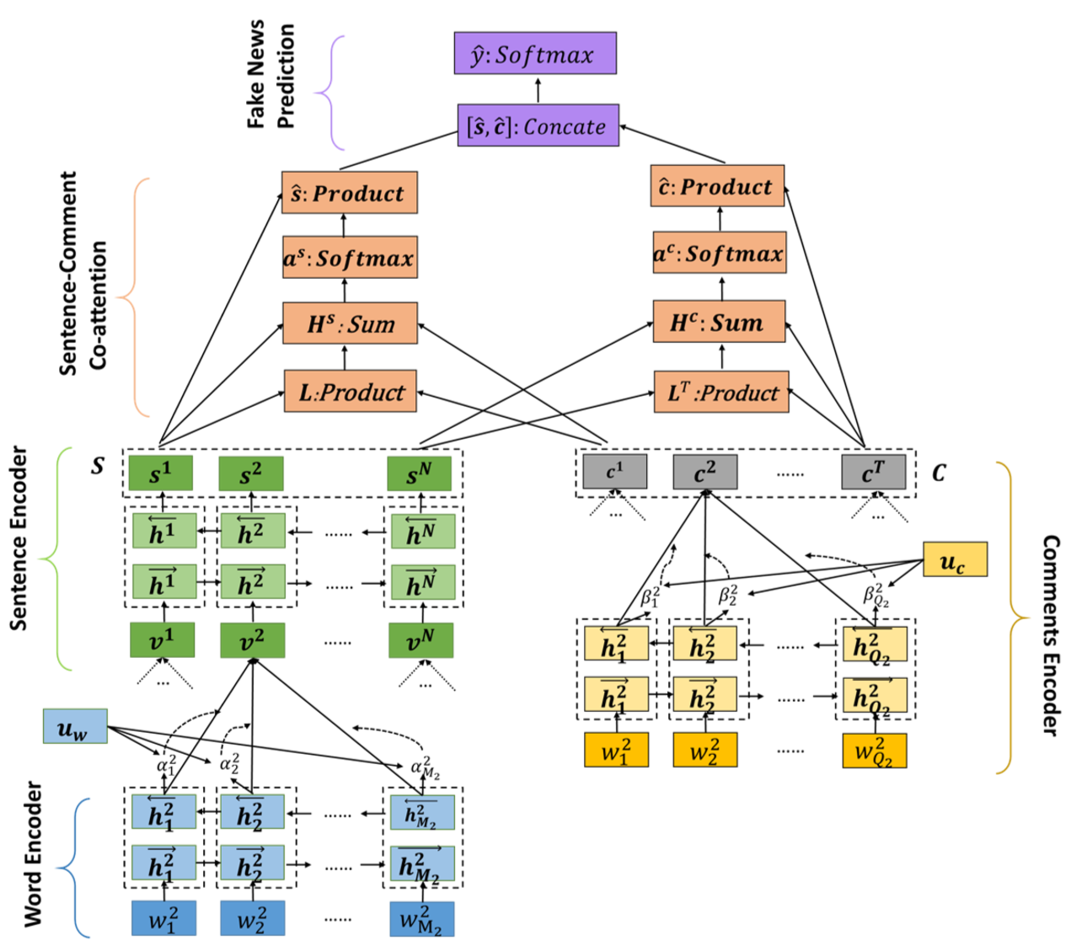
dEFEND explains why it is fake
A hierarchical attention network to capture world-level and sentence-level structure
An attention-based bidirectional
GRUnetwork to model word sequences in comments
A co-attention network to model the relationship between contents and comments
Notes:
Gated Reuccrent Units (GURs)

Slide 19
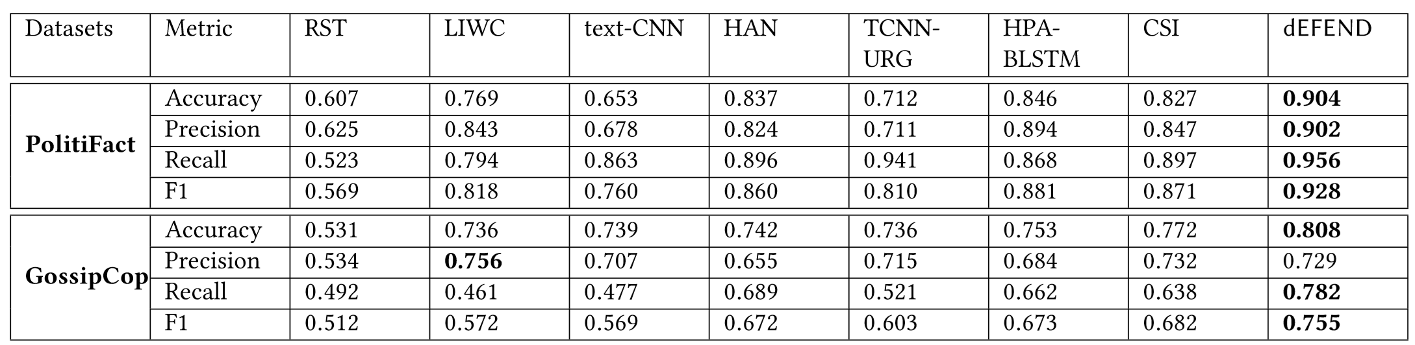
Evaluation Results - Detection Performance
User comment based methods are more effective than news content based methods
dEFEND performs the best than other methods using both news content and user comments
User Comments
News Content
News Content + Social Context

Slide 20
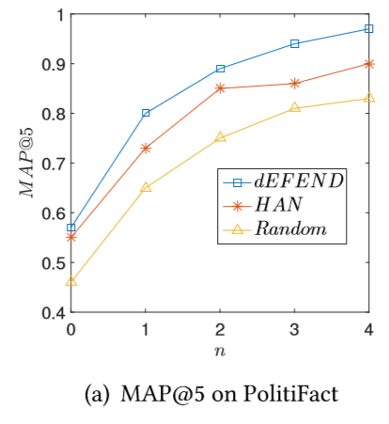
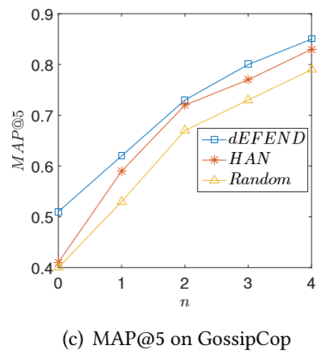
Evaluation Results - Explainability
News sentence explainability: the degree of check-worthy
Ground truth: obtained with ClaimBuster [1]
dEFEND can achieve better performance to capture more check-worthy sentences than HAN and random
With the increase of window size n, the MAP performances increase
Amazon Mechanical Turk
used on user comments

Slide 21
Summary
A new framework for the novel problem of explainable fake news detection
Achieves higher accuracy than the state-of-the-art fake news detection methods
Discovers explainable news sentences and user comments to understand why news pieces are identified as fake

Slide 22

Recent work on Fake News Detection
Book: Detecting Fake News on Social Media
Edited book: Misinformation, disinformation, and fake news.
Survey: Fake News Detection on Social Media: A Data Mining Perspective
Data repository: FakeNewsNet, [Github], [Kaggle], [Paper]
Software: FakeNewsTracker
Book chapter: Studying Fake News via Network Analysis: Detection and Mitigation
Other Publications: related publications are updated at: http://www.public.asu.edu/~skai2/
http://dmml.asu.edu/dfn/

Slide 23
Acquiring and Using Knowledge
Causal learning to acquire knowledge
  Explainable for understanding
  Not specific to one domain for reuse
Evaluation via explanation
  Enabling expert’s verification and intervention
  Facilitating knowledge extraction

Slide 24





THANKS with Repositories, Surveys, and Books
scikit-feature – a feature selection repository in Python
Two Recent Surveys:
Learning Causality with Data: Problems & Methods
Privacy in Social Media: Identification, Mitigation,
http://www.public.asu.edu/~huanliu
Notes:
Social Computing Repository

Slide 25

Call for Authors

